Slide 1



GPS APP
Group A
GPS ASSISTED SEARCH FOR RECYCLING POINTS

Slide 2

Our Imaginations and Expectations
Group A
Meeting every week in AC..?
Menue-bar, or drop down-menue..?
Design in colors, like the knwon recycling-symbol..!?
More HTML or Java..?
Who does what..?
It should work on an iPhone..!
Beside GPS-Search also search by list..?
Adding new recycling stations..?

Slide 3
Work distribution
Group A
Work distribution based on present knowledge of Groupmembers
Teamleader & Organisator
Designing-Team
Programming Team

Slide 4
First steps
Group A
Gathering Data for the database [ GER & FR ]
GPS coordiantes
streets
Pictures & more
Our Ideas how to make the Application
Menue-Bar
Search by List
Splash-Screen in front of starting the App
Colors& more for the whole Design

Slide 5

Designing in Photoshop
Group A

Slide 6
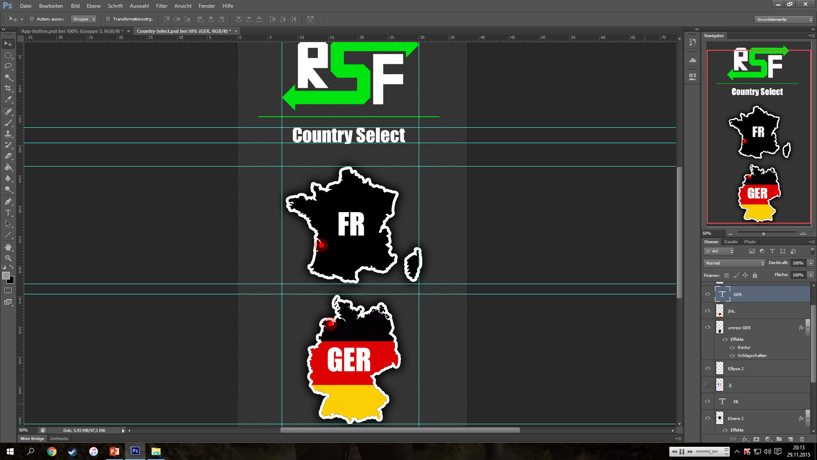
Designing in Photoshop
Group A

Slide 7


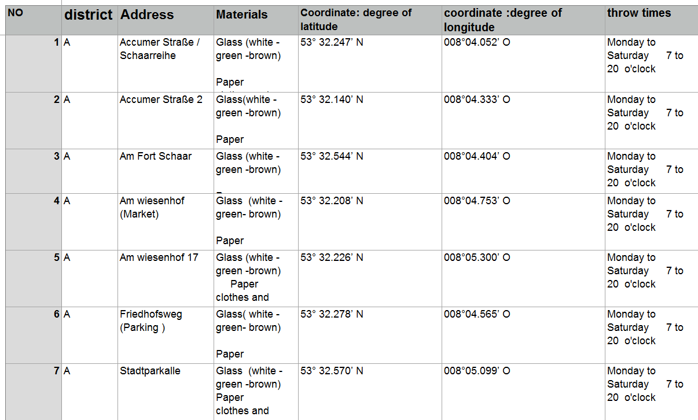
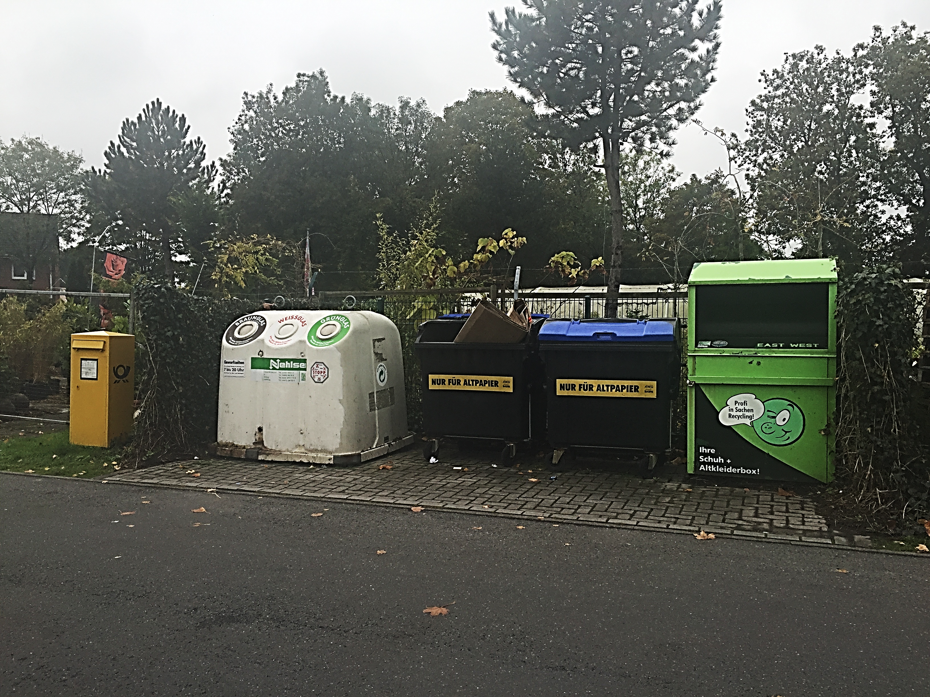
Gathering Data
Group A

Slide 8
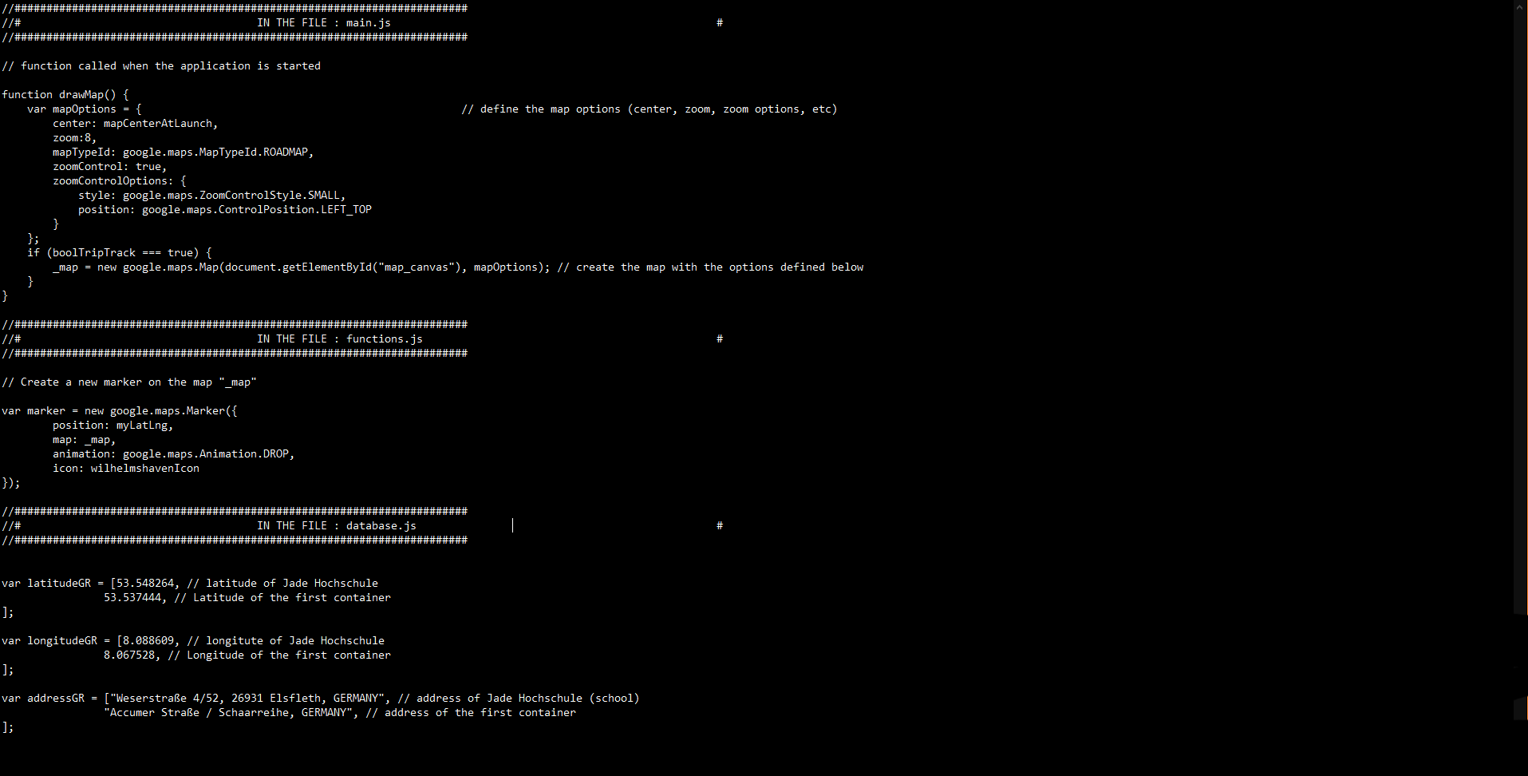
The Source-Code
Group A

Slide 9
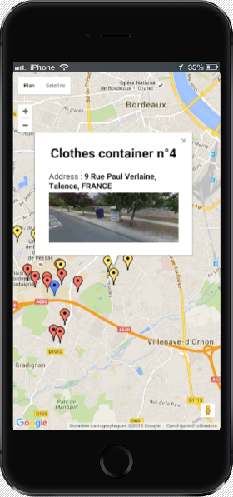
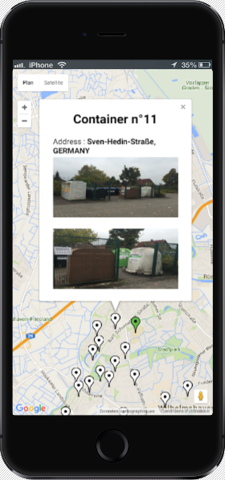
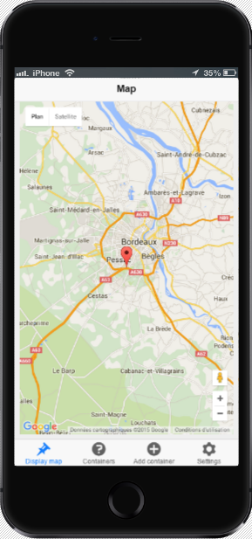
Examples/Screenshots from the App
Group A
1
2
3

